Slide 1
Artificial Intelligence
Enrique Peláez Ph.D.

Slide 2
Agenda
Definition of Artificial Intelligence
Fundamentals of Artificial Intelligence
History of Artificial Intelligence
Why Artificial Intelligence?

Slide 3
Definition of Artificial Intelligence
AI is part of the Computational Sciences, focus on the creation of HW and SW with intelligent behaviour.
AI refers to the techniques that allow systems to perform intelligent perception, reasoning and behaviour.
AI looks for techniques to make the machines outperform tasks, that in some cases, are still better performed by humans.

Slide 4
Definition of Artificial Intelligence
Long term objectives
  To develop systems that reach the level of “intelligence” similar/comparable/better than humans.
  It is possible to occur within the next 10-15 years
Short term objectives
  In specific tasks: To develop systems that reach levels of “intelligence” similar/comparable/better than humans
  Today there exist several systems that actually outperform humans, in some orders of magnitude.

Slide 5
Definition of Artificial Intelligence
Within the context of the short term objectives:
  AI is not looking for “simulate” human intelligence.
  But, it looks for “reproducing” the effects of an intelligent behaviour.
Analogy with flying

Slide 6
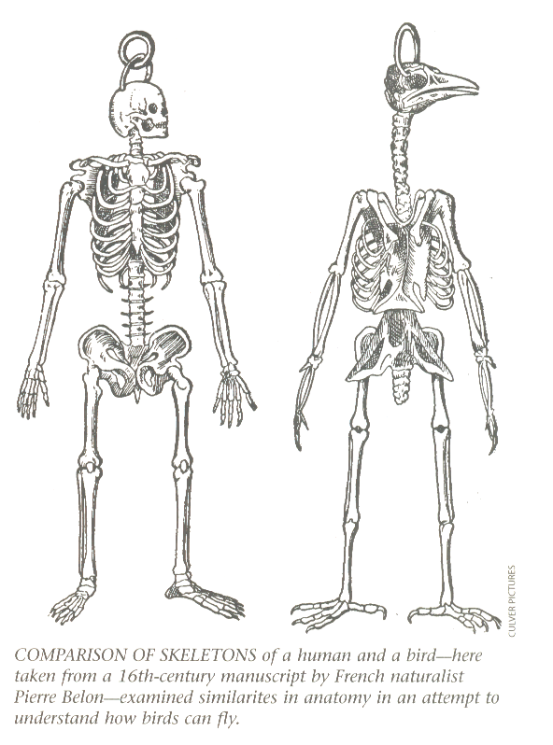
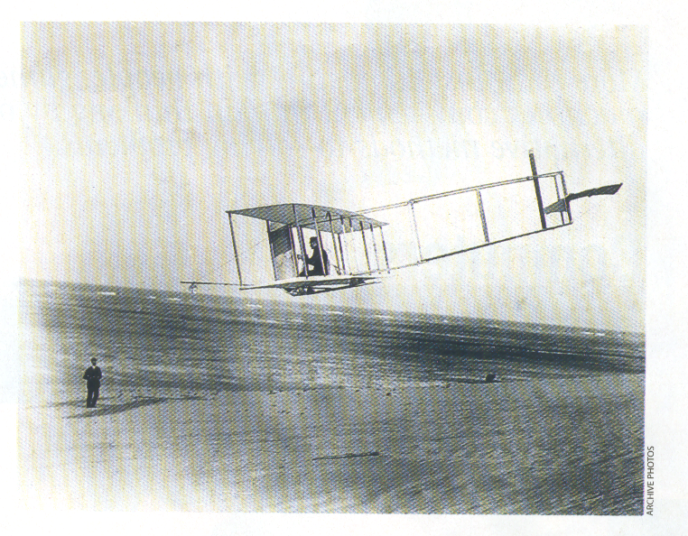
Definition of Artificial Intelligence

Slide 7
Applications in AI
Everyday tasks:
  Perception (vision y talk)
  Natural Language processing (comprehension, translation)
  Common Sense
  Robot control
Formal tasks:
  Games (Chess, backgammon)
  Math (geometry, logic, calculus, algebra)
Expert tasks:
  Engineering (design, FMEA, planning, manufacturing)
  Scientific analysis
  Diagnosis in Medicine, Health
  Financial analysis …

Slide 8
Applications in AI
Learning:
  Automatic knowledge acquisition.
Reasoning:
  Knowledge based systems.
  Intelligent data bases.
  Games and Theorem provers.
Perception:
  Natural language comprehension.
  Visual interpreters (Computer Vision).
Locomotion and Manipulation:
  To perform mechanical and manual processes (Robotics).
Creation:
  To generate, verify, depurate and automatic optimization of programs.

Slide 9
Fundamentals in AI
During the last 2000 years, Philosophy has contributed with diverse and multiple theories about reasoning and learning.
During the last 400 years, Math has contributed with formal theories related to logic, probability, decision and computation theory. Math has provided the tools to manipulate certainty in logic, as well as uncertainty in probability. Math has also put the grounds for managing reasoning using algorithms.
Psychology also has contributed with tools to allow current research about the human brain, and has provided the scientific language for expressing the theories. Physiologists have reinforce the idea that humans and other animals might be modelled as machines for processing information.

Slide 10
Fundamentals in AI
Linguistics also has offered theories about the structure and meaning of language. Linguists have demonstrated that the use of a language also follows a structure.
Computer Science has provided the computational tools for making of AI a reality.
Computer Engineering has also contributed to the field, providing solutions for making AI systems a reality. AI programs are generally big and will not perform without the speed, memory capacity and computational power of today’s devices.

Slide 11
Fundamentals in AI
The sciences that contribute to the development of AI are:
  Philosophy
  Medicine
  Mathematics
  Psychology
  Linguistics
  Computer Science and Engineering

Slide 12
History of Artificial Intelligence
1950-1965. Classic Period'
  Harvesting [McColluck y Pitts, Shannon, Turing]
  1956, AI has its impulse after the Conference in Darmouth College. McCarty named the field as AI. Minsky (founder of MIT’s AI lab), Shannon (Bell labs), Rodhester (IBM), Newell (president of A.A.A.I. American Association of AI), Simmon (Nobel laureate from Carnegie Mellon University)
  Neural Nets, robotics (Shakey)
  State search, Heuristcs, LISP

Slide 13
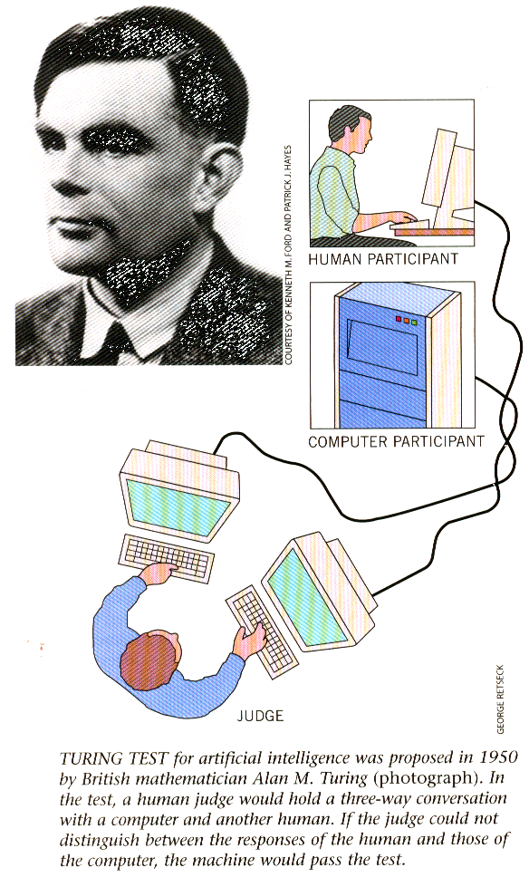
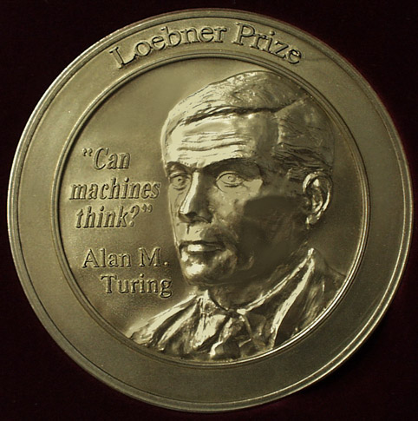
History of Artificial Intelligence
Turing Test

Slide 14
History of Artificial Intelligence
1950-1965. Classic Period…
  General Problem Solvers (GPS) [Newell, Simon]. Common Sense problems, which include reasoning about physical objects and their relationships, reasoning about actions and its consequences. Simple tasks only were resolved, because there were not enough knowledge about a specific domain.
  Main focus in implementation of games (chess, backgammon), as well as math theorems demos.
  Limitations in searching, combinatorial explosion.

Slide 15
History of Artificial Intelligence
1965-1975. Romantic Period
  “General” representation of knowledge
  Semantic nets [Quillian]
  Prototyping (frames) [Minsky]
  Perceptron [Minsky y Papert]
  Logic [Kowalski]
  Block worlds [Winograd]
  Perception (vision y speaking), natural language comprehension, robotics.

Slide 16
History of Artificial Intelligence
1975-Today. Modern Period, “Specific” Intelligence vs. “General''.
  The need for collaboration with other knowledge fields has been identified.
  Explicit representation of very specific knowledge domains.
  Expert System MYCIN (Stanford University)
  Knowledge based Expert Systems.
  Neural Nets are back[Hopfield, Rumelhart, Hinton], genetic algorithms [Holland, Goldberg]
  Voice recognition, uncertainty (Bayesian Nets, Fuzzy Logic), planning, learning.
  Real applications (medicine, finance, engineering, exploration, etc.).
  Commercialization of AI.

Slide 17
Why Artificial Intelligence?
Two purposes
  To use the computational resources for empowering the human thinking and development; just like we use motors to increase the strength or power. Robotics and the Expert Systems are 2 examples.
  To understand how humans think. Not only to figure it out “what” is, but also “how” it is done. The cognitive sciences is an example.

